Slide 1
PRA Group project Assignment -2
Group – 5
Batch - 1

Slide 2
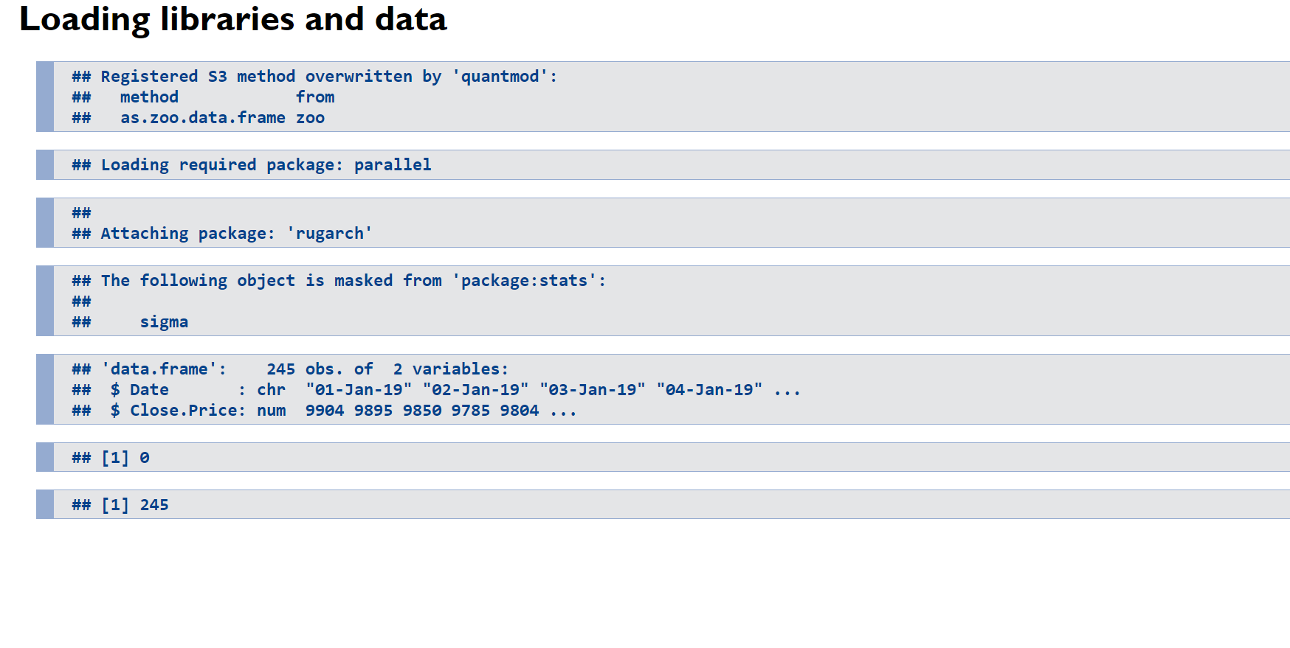

Slide 3
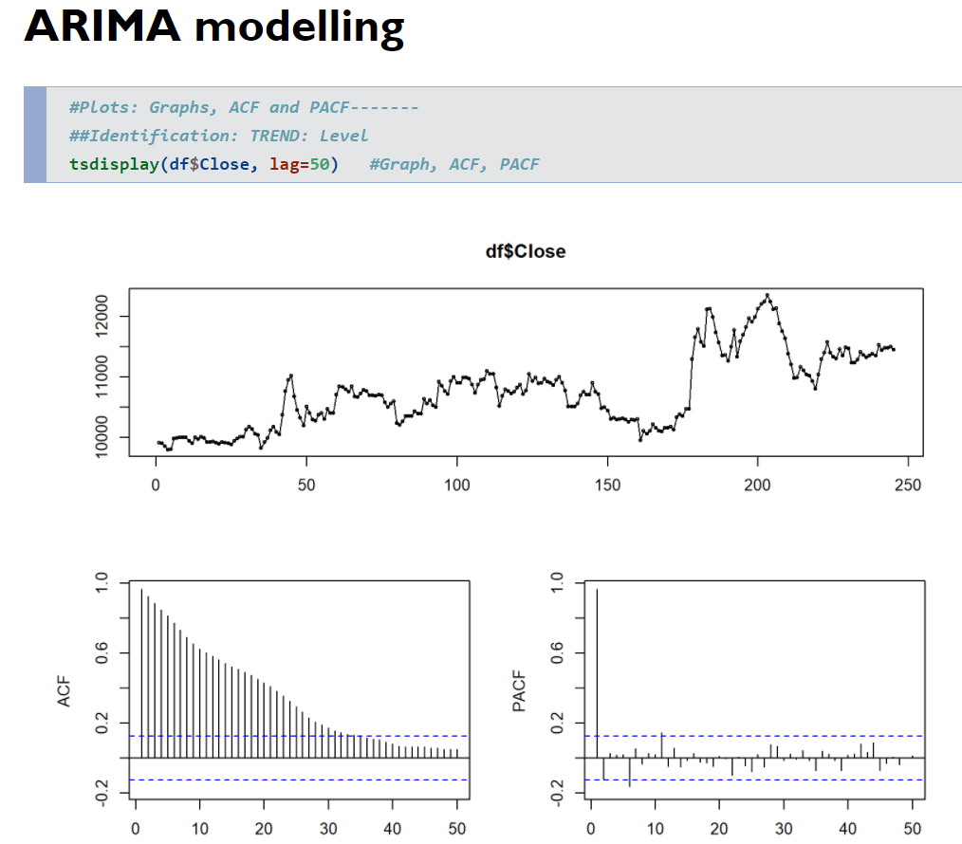
ACF plot indicates that the autocorrelation starts at a very high and is not decaying fast which means the series is non stationary. Hence, we will go for first differencing

Slide 4
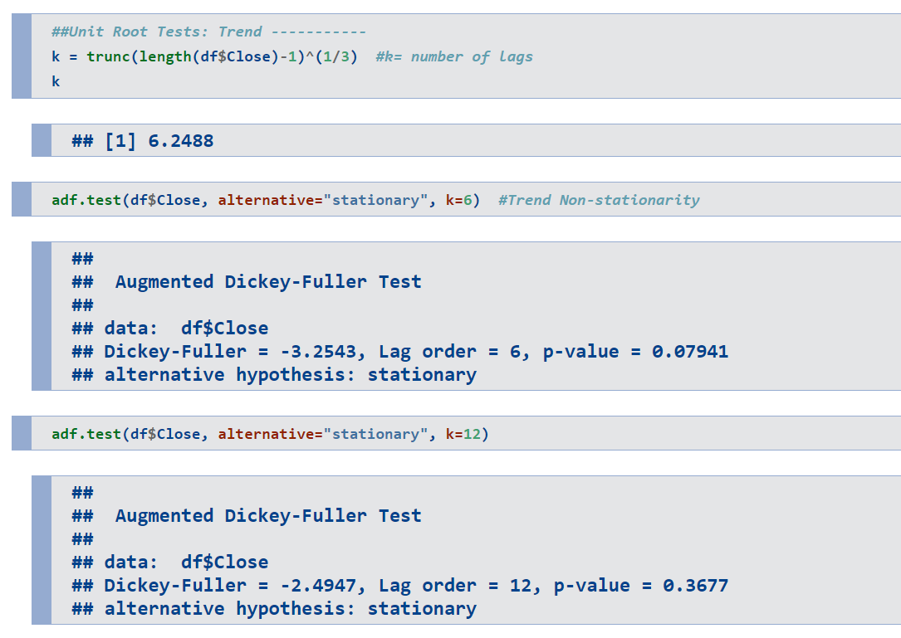
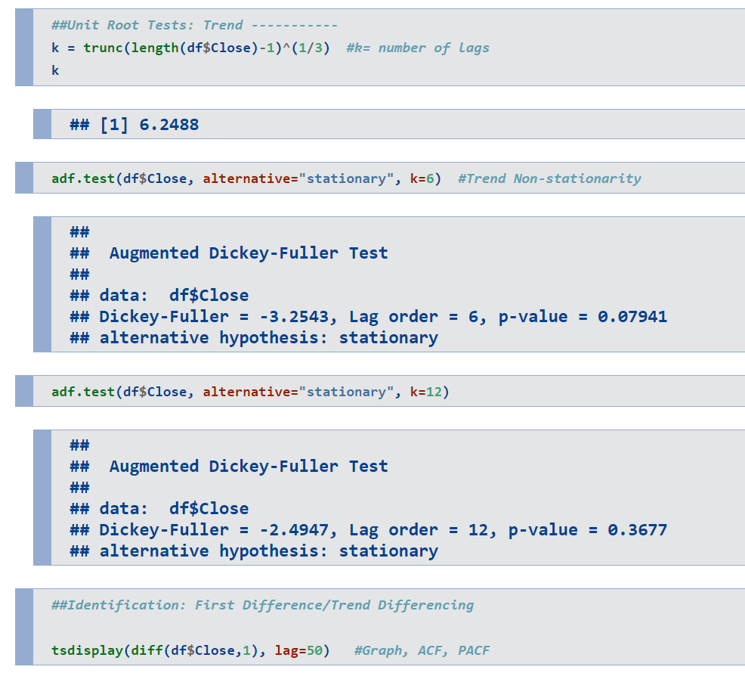
The p-value of the ADF test is greater than 0.05 which is statistically proving that the data is non stationary

Slide 5
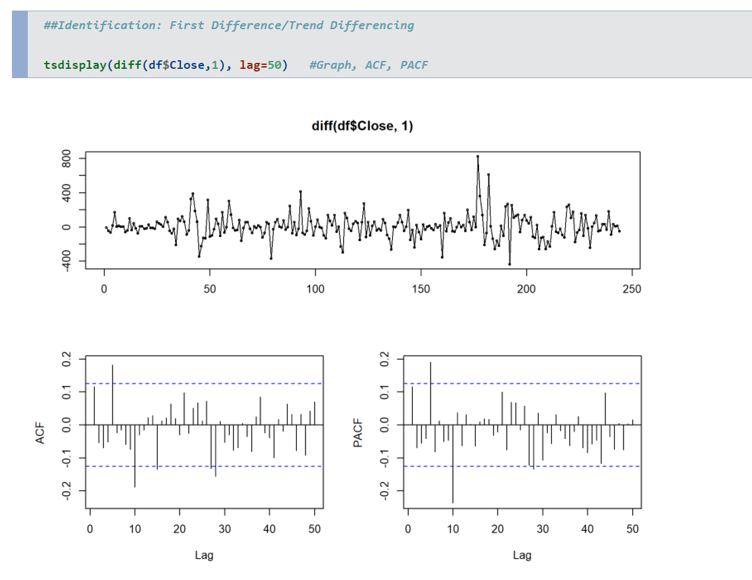
It can be seen that there are some significant lags in pacf plot. Hence, we will consider trend differencing in our ARIMA model

Slide 6
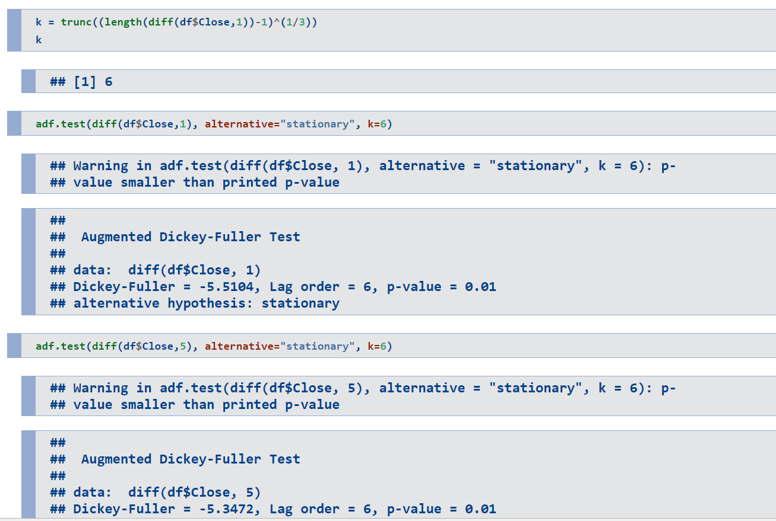
The p-value of the ADF test for seasonal differencing is less than 0.05 which means it is significant and stationary

Slide 7
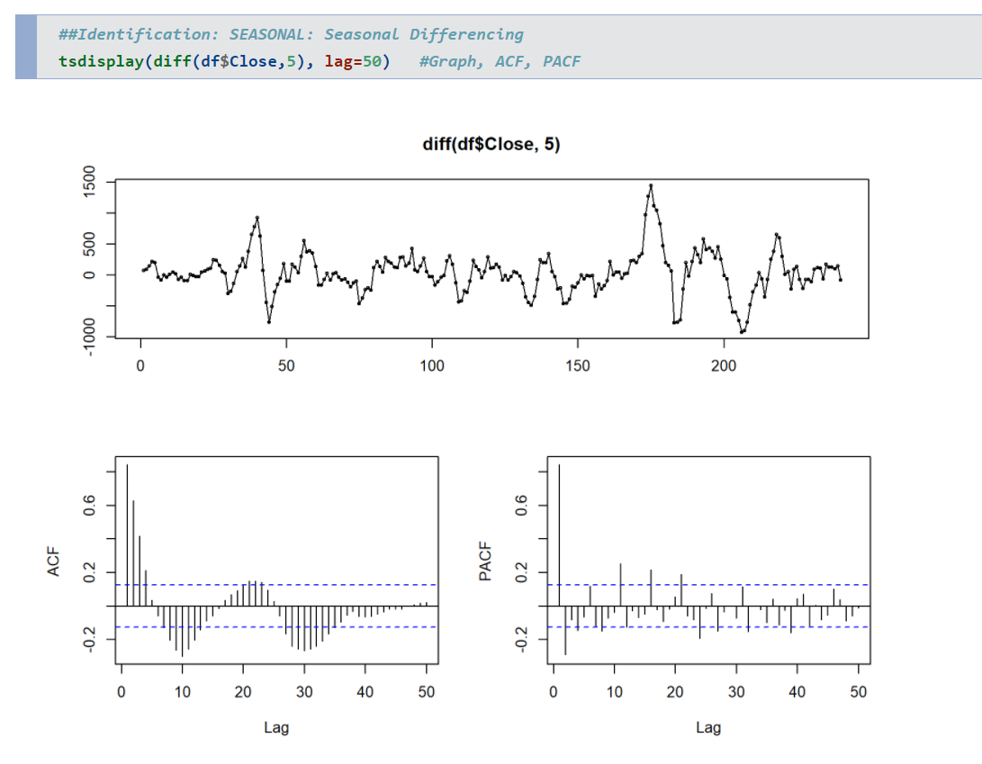
The ACF plot is showing a seasonal pattern
The PACF plot shows which lags are significant

Slide 8
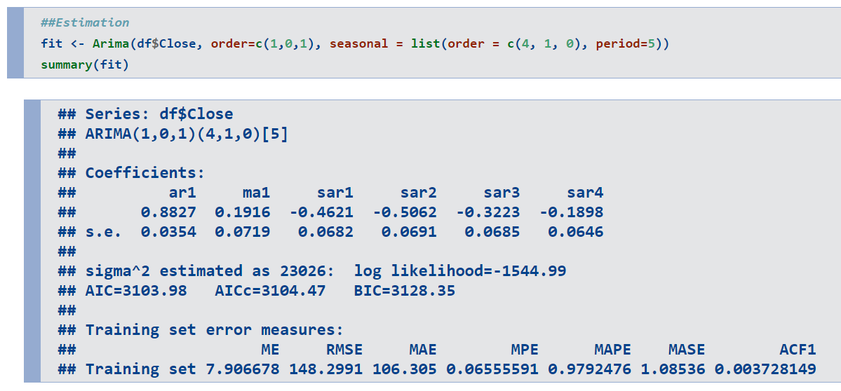

Slide 9
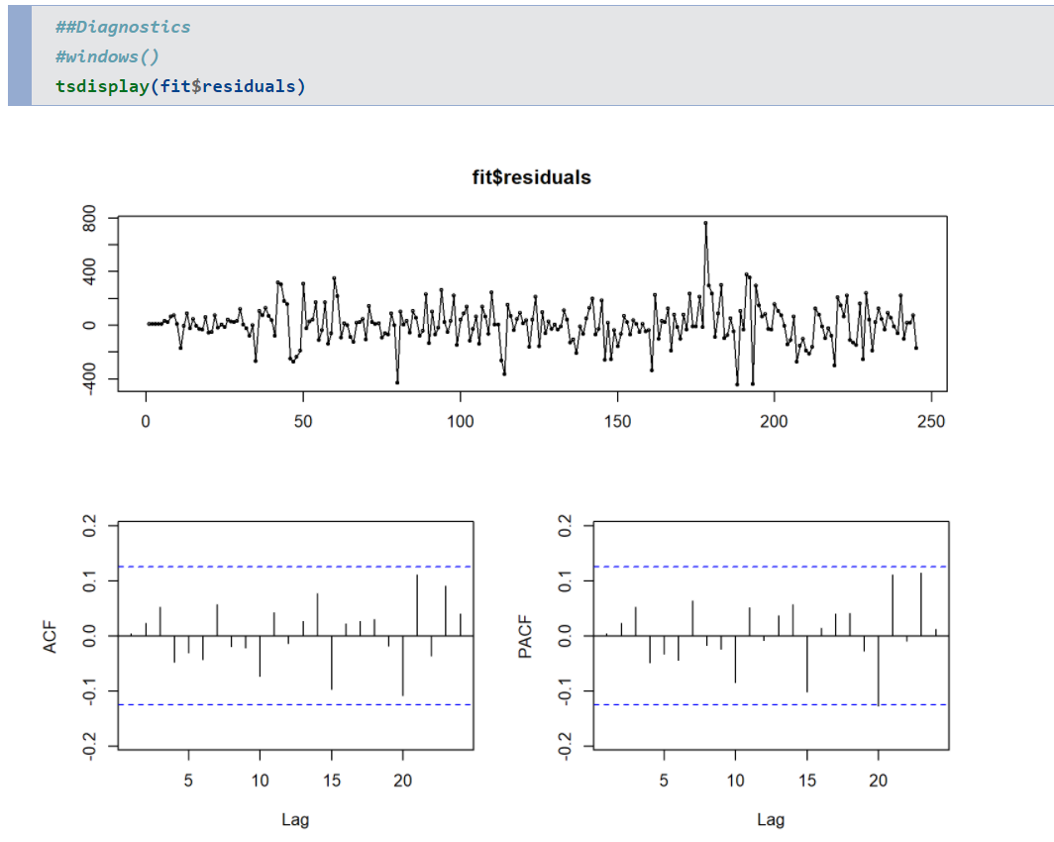

Slide 10
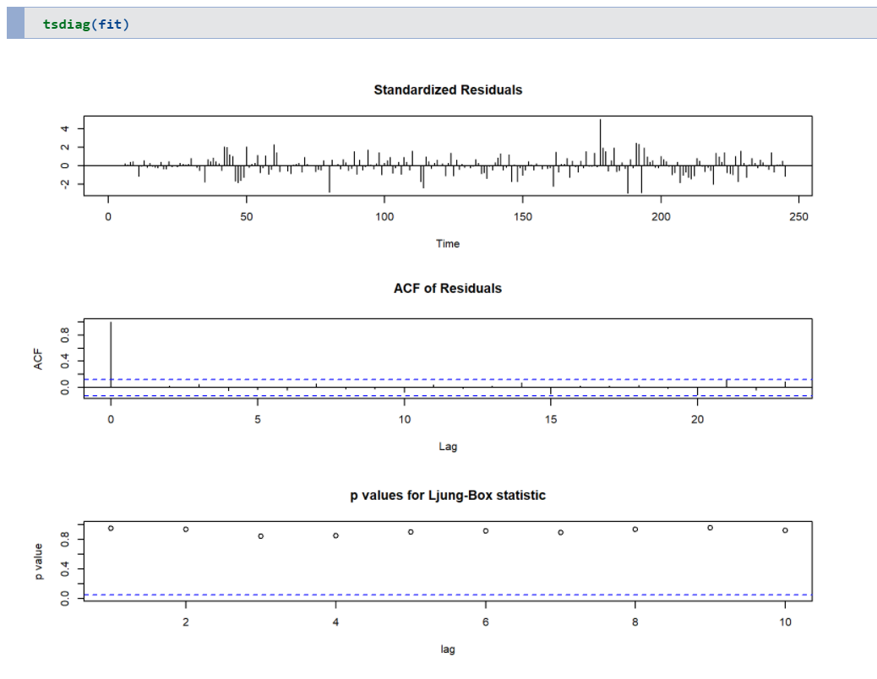
All the p-values are greater than 0.05 so we are accepting the alternative hypothesis that there is no autocorrelation and all the predictable information has been captured by our model

Slide 11
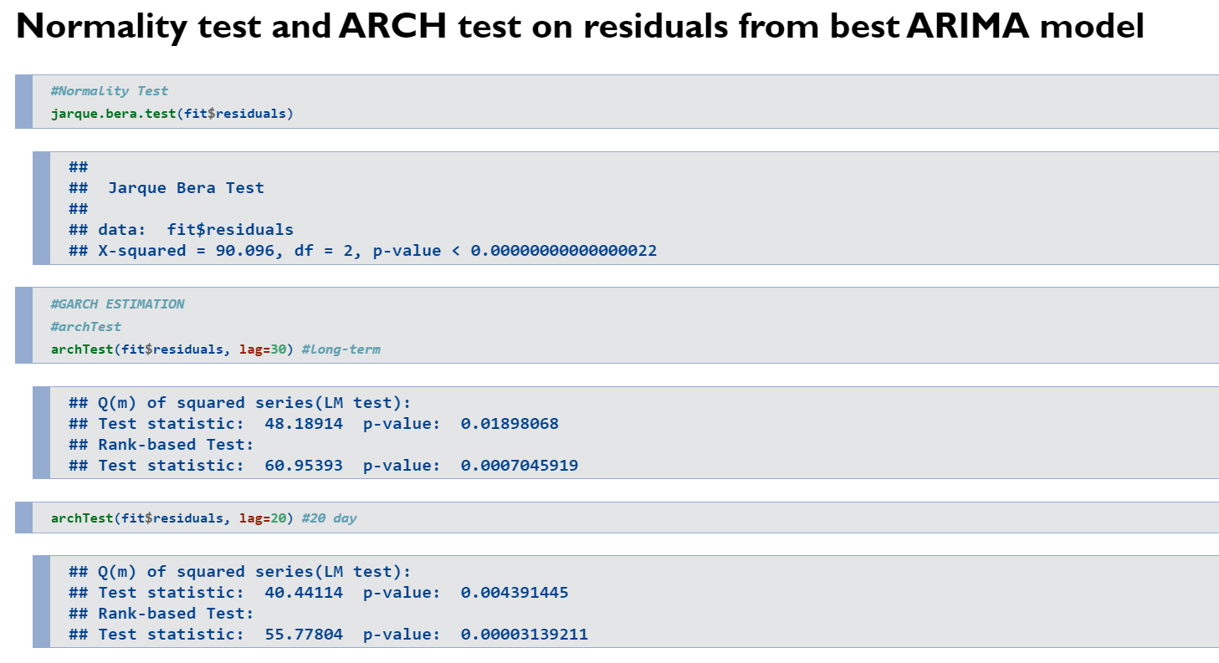
Since the p-value is less than 0.05, we will not accept the null hypothesis that is the series does not follow normal distribution
Since the p value of Q(m) test for all the lags is less than 0.05, it means that our residual series obtained from the ARIMA best fit model is heteroscedastic.

Slide 12
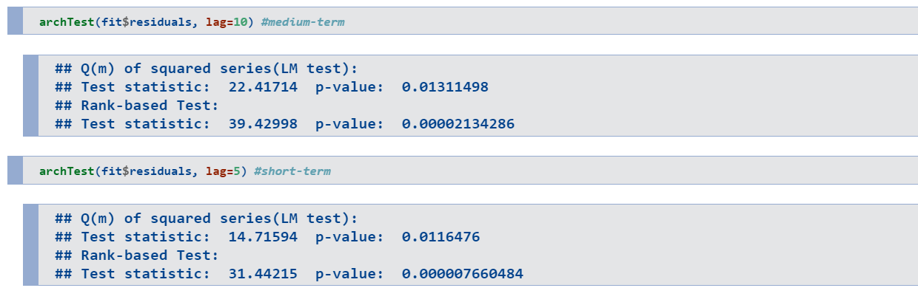
Since the p value of Q(m) test for all the lags is less than 0.05, it means that our residual series obtained from the ARIMA best fit model is heteroscedastic.

Slide 13
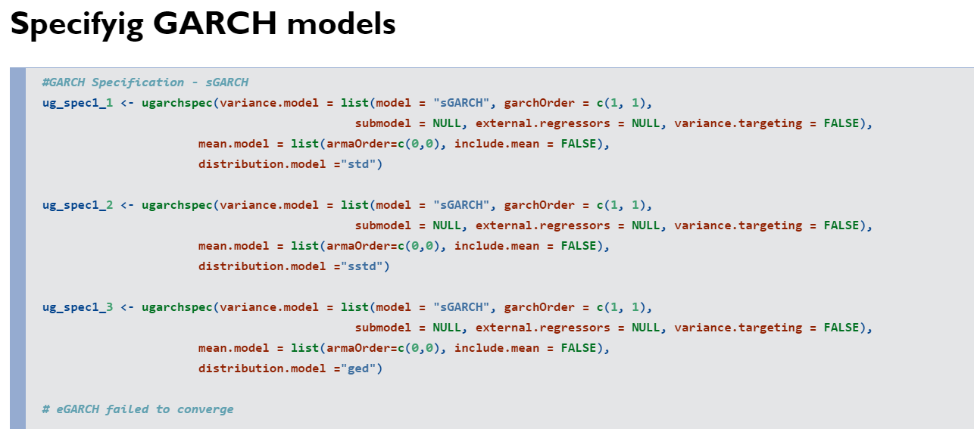
Since there was an arch effect on short mid and long term we have used sGARCH of order (1,1) to take care of impact of high peaks and volatility clustering in the residual squares with three distribution

Slide 14
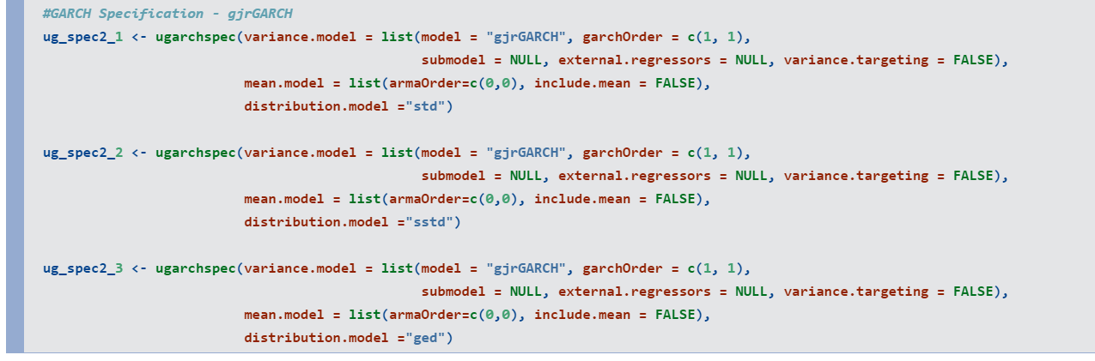
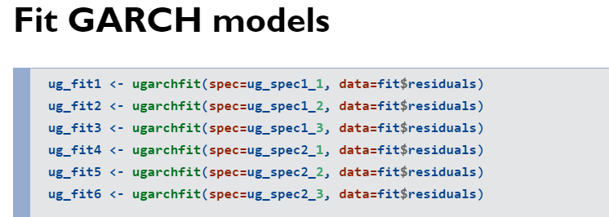
Models based on gjrGARCH
Since eGARCH failed to converge, we’ve chosen our next model to be gjrGARCH will take care of the leverage effect of negative news using the dummy variable (whose coefficient is represented by gamma in the model output). This also gives us an idea as to how negative news has impacted the volatility for the given time period.

Slide 15
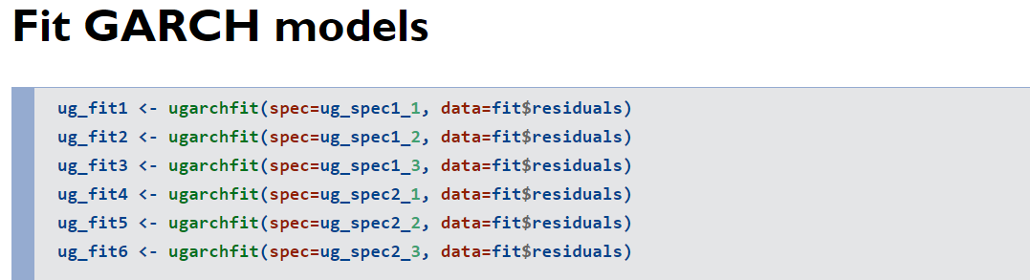
All the models selected so far is fitted and the significance of the coefficients are checked (for stationarity the coefficient should have absolute values less than 1 and should have t value more than 1.96 in absolute value.

Slide 16
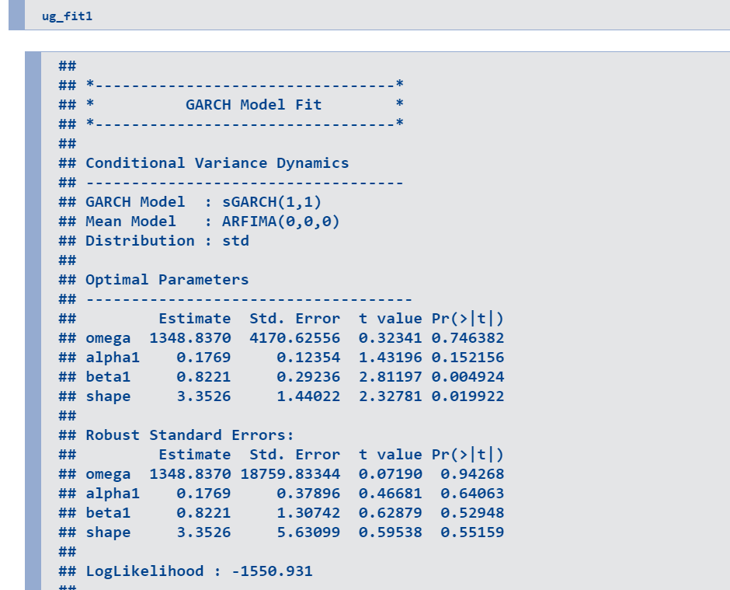
Model estimation on residuals of ARIMA model for various GARCH models

Slide 17
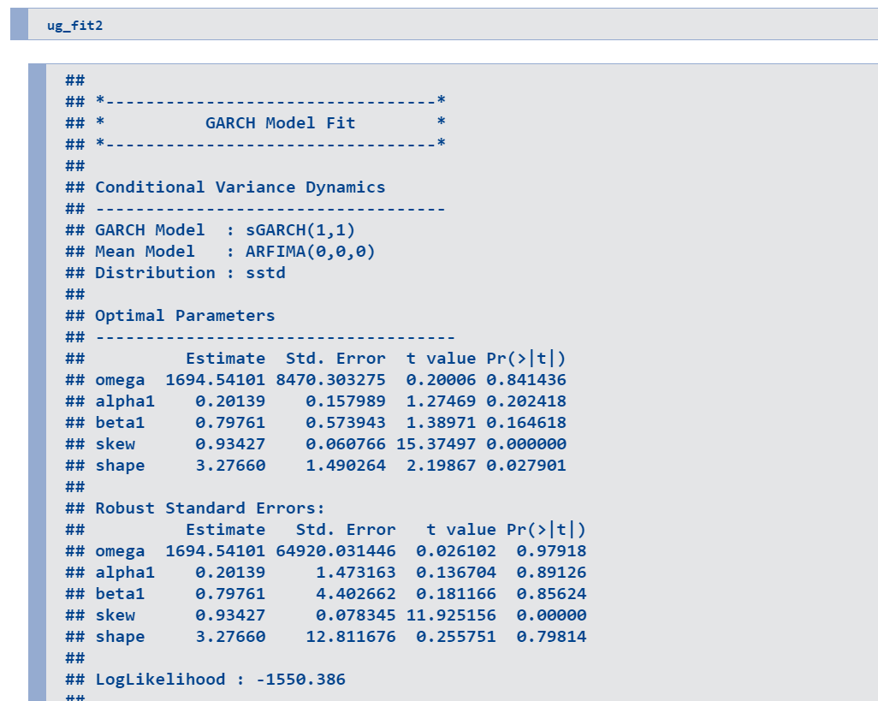

Slide 18
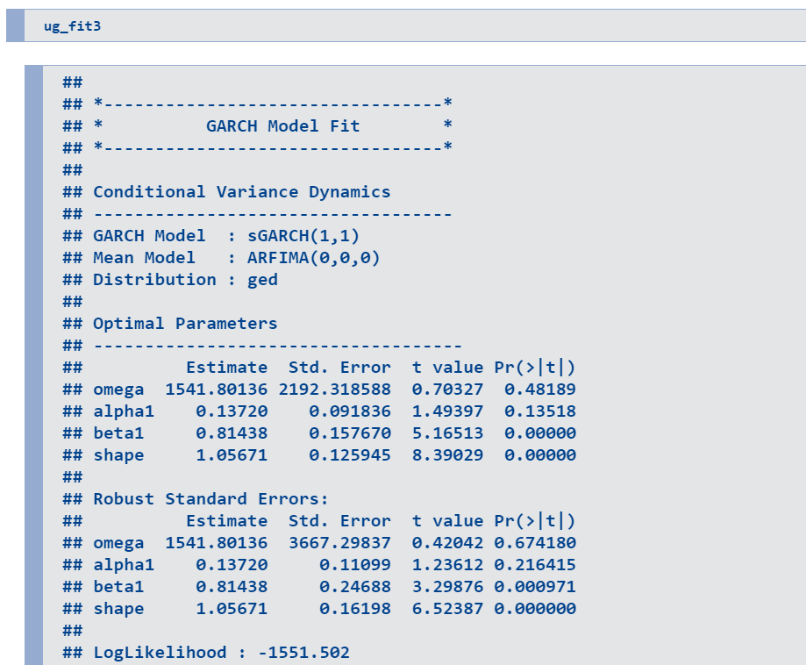

Slide 19
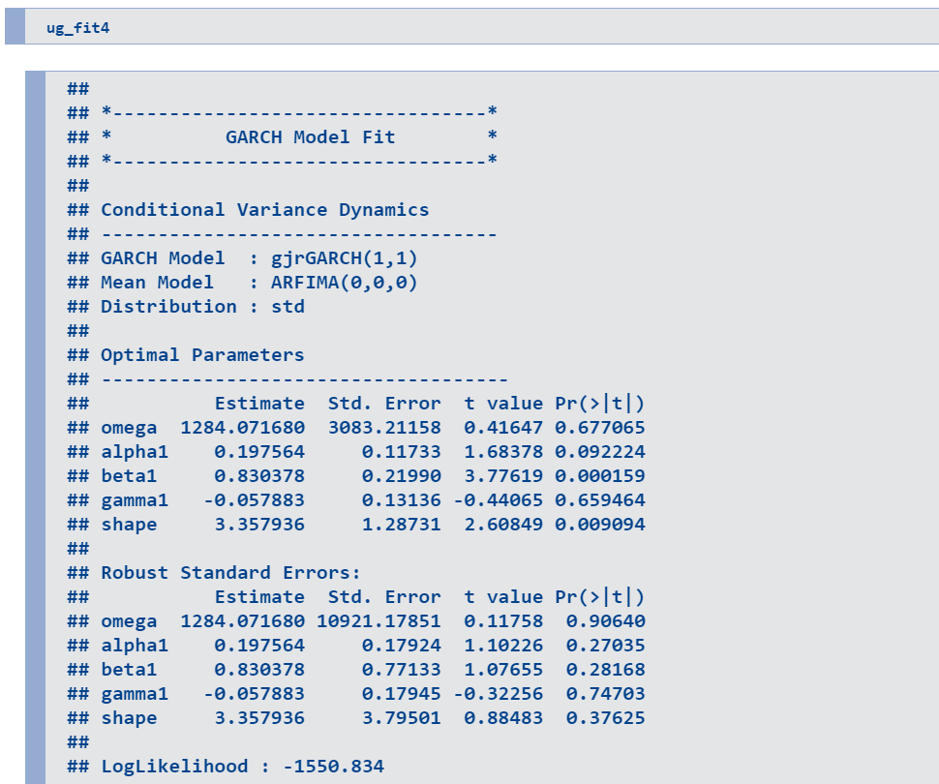

Slide 20
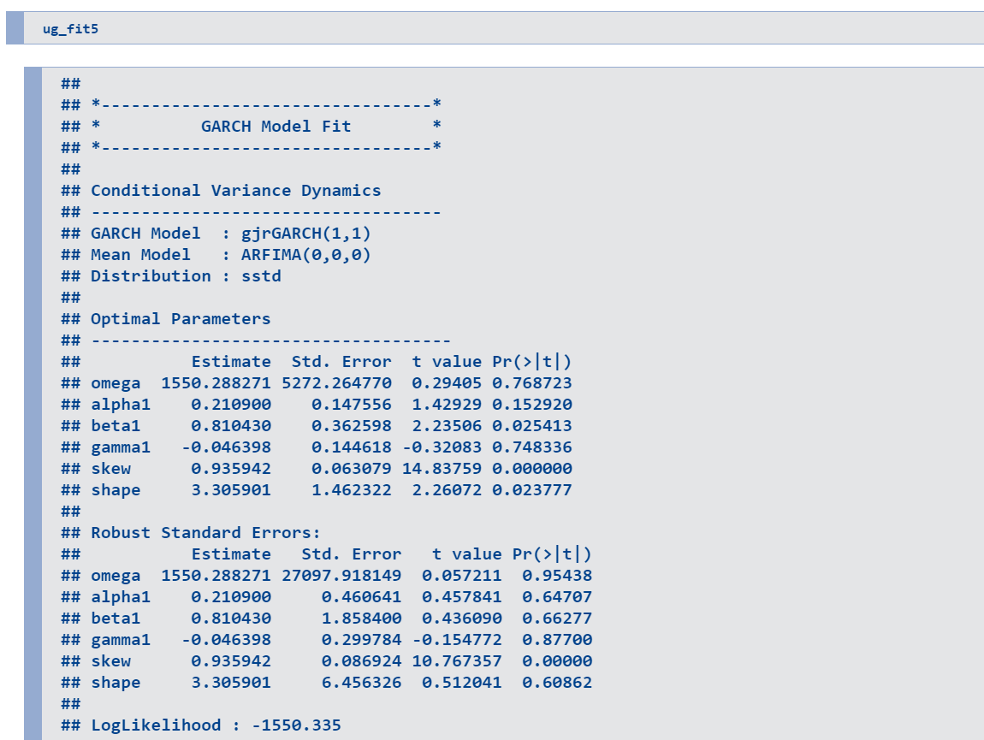

Slide 21
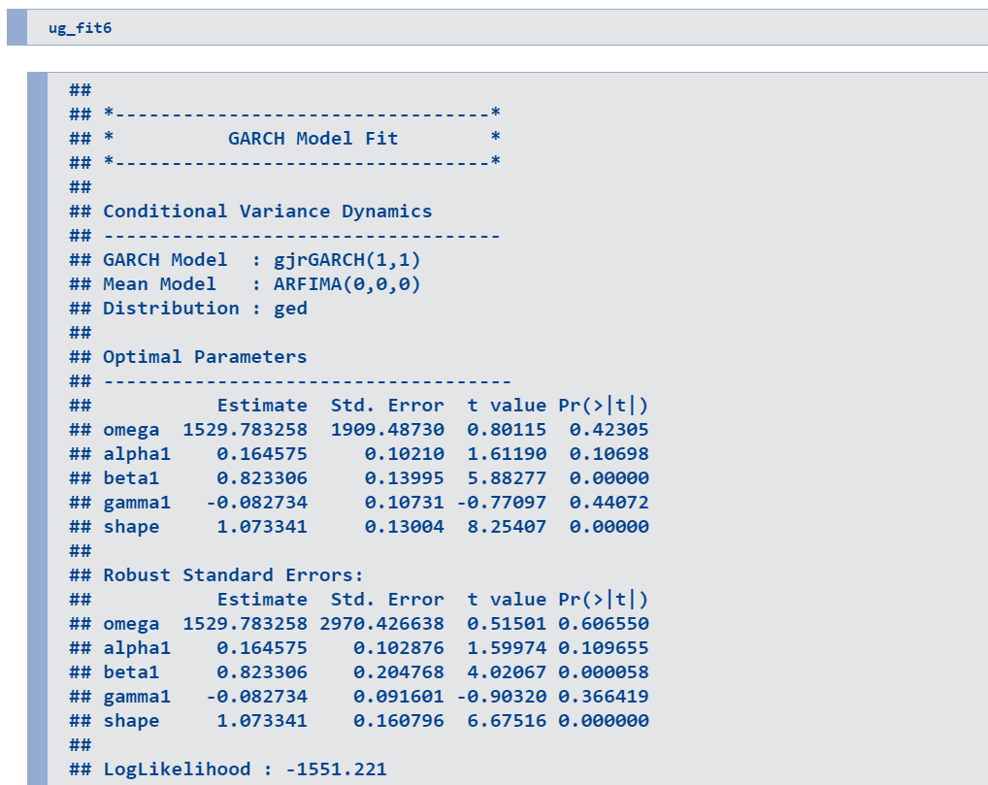

Slide 22
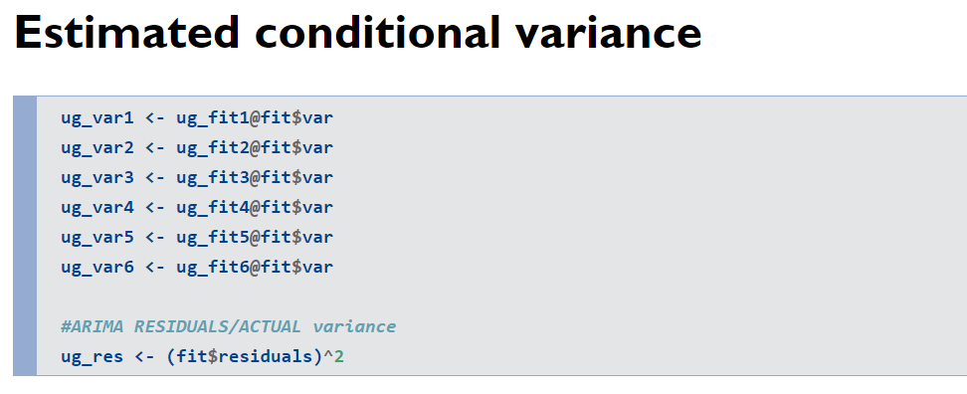
Here, variance is estimated from the GARCH model and then compared with the actual variance (with the residuals square obtained from the ARIMA model)

Slide 23
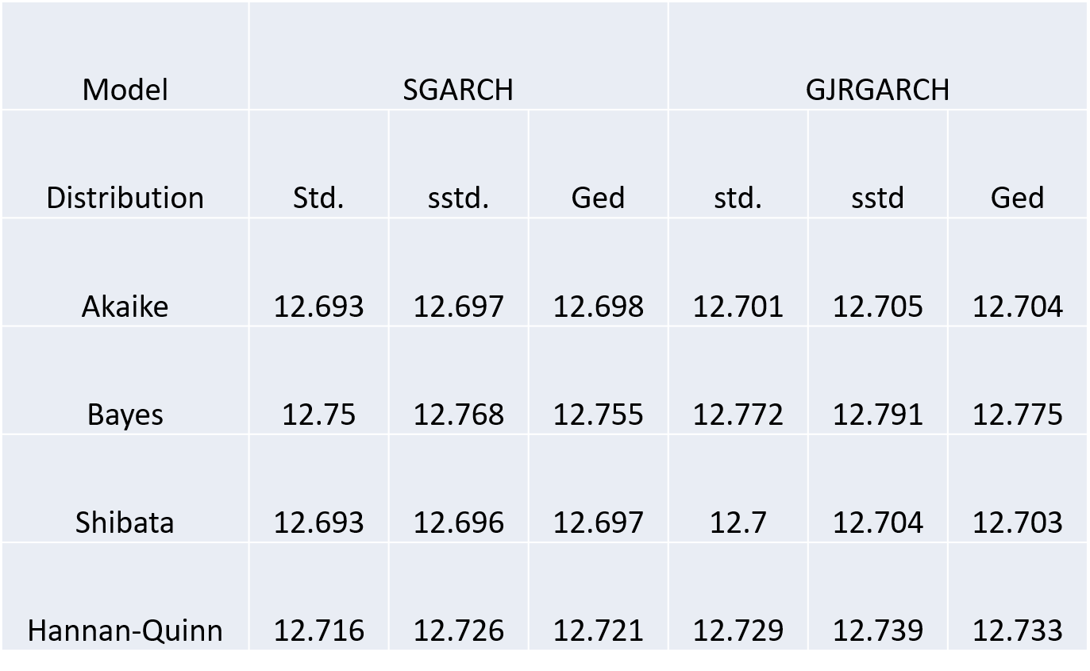
Comaprison of GARCH models

Slide 24
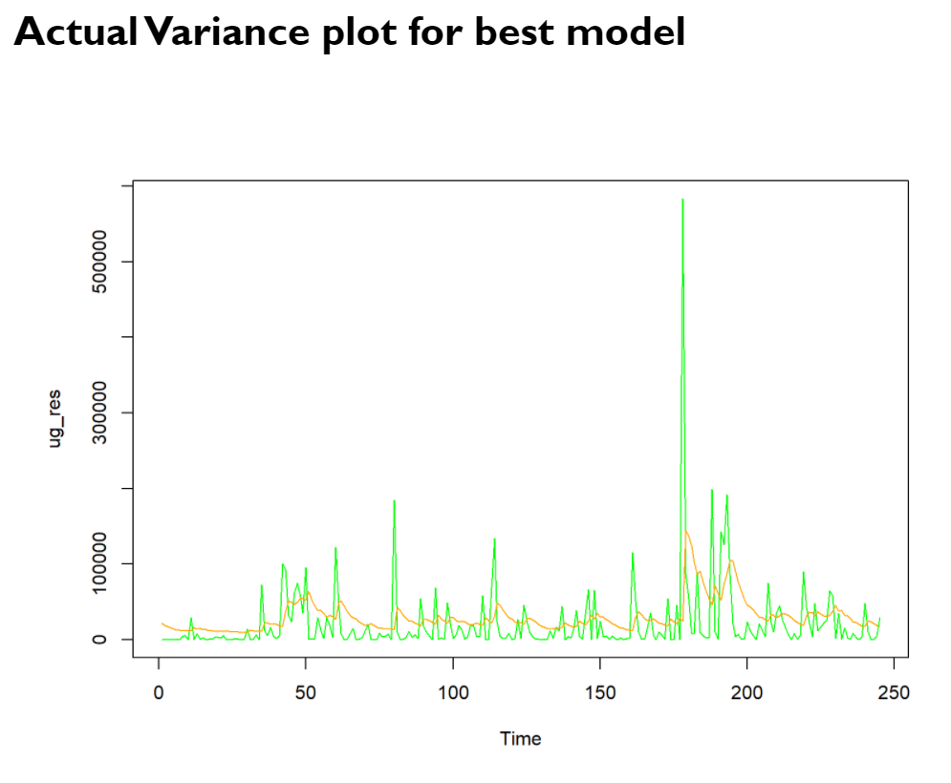
Here, green line depicts the actual variance and and yellow line depicts conditional variance obtained in the GARCH modeling

Slide 25


Thank you…

